Slide 1
Tunnel Effect in CNNs:
Image Reconstruction
From
Max-Switch Location
March, 5th 2018 v0.1
Matthieu de La Roche Saint-André
Akeneo, SIIT

Slide 2
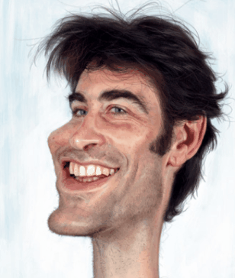
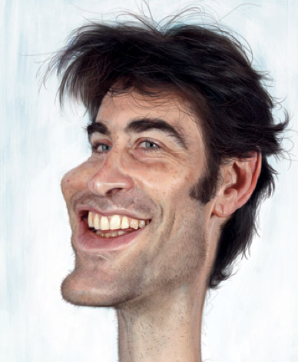
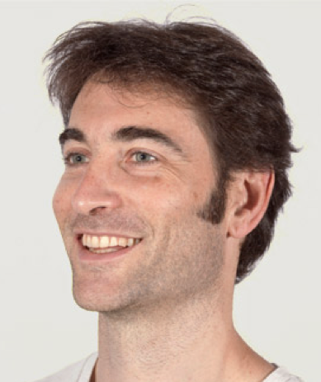
You Deserve Ugliness
Matthieu de La Roche Saint André

Slide 3

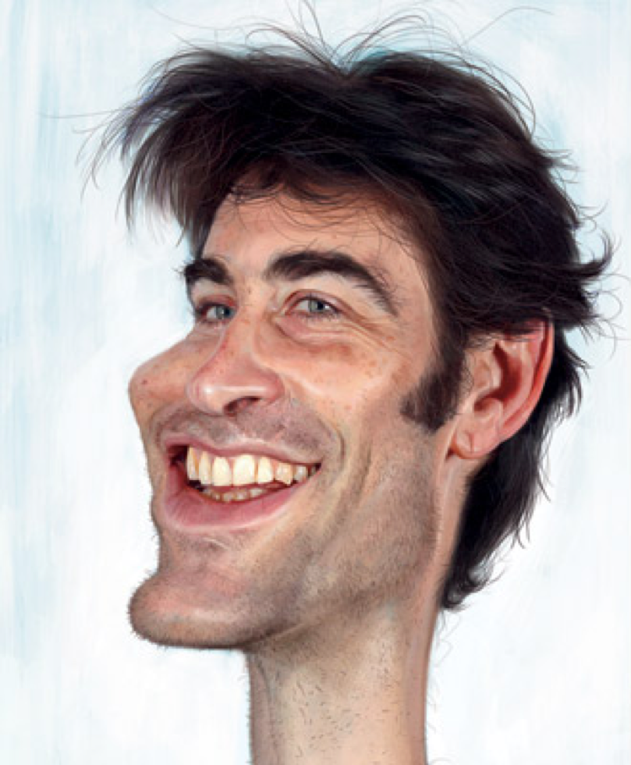

You deserve ugliness
Instant Ugly Face
Matthieu de La Roche Saint André

Slide 4
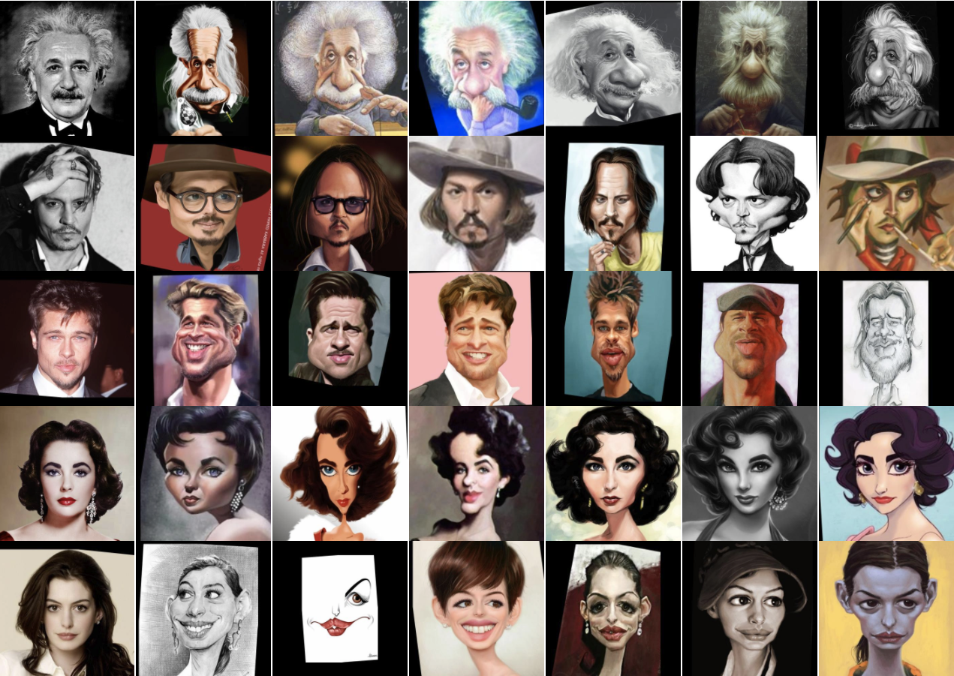
Dataset of caricatures
Our dream:
Reality back in 2015: Nothing
=> Unsupervised Learning
Since 2017: WebCaricature
Huo, Jing, et al.
"WebCaricature: a benchmark for caricature face recognition."
https://cs.nju.edu.cn/rl/WebCaricature.htm
Matthieu de La Roche Saint André

Slide 5
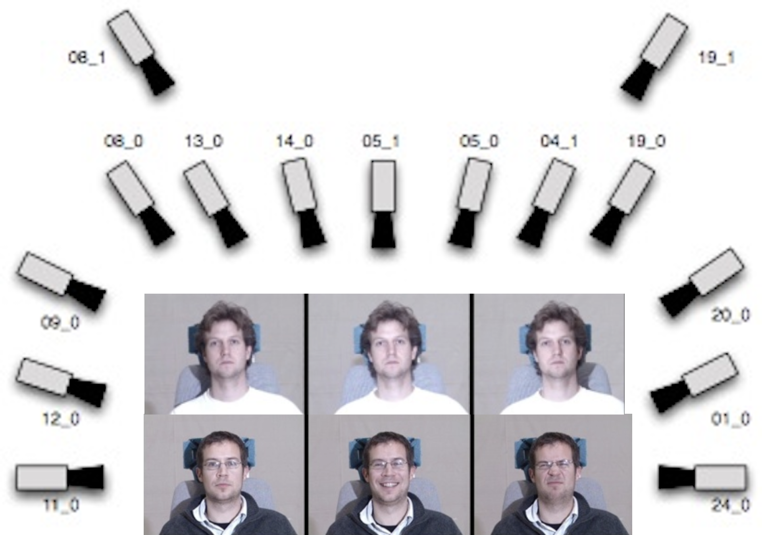
MultiPie
750,000 images
337 people
19 illuminations
15 camera views
6 expressions
Matthieu de La Roche Saint André
http://www.cs.cmu.edu/afs/cs/project/PIE/MultiPie/Multi-Pie/Content.html

Slide 6

Face2vec
Instant Ugly Face
1.1
0.9
1.0
0.1
4.4
1.1
0.9
1.0
0.5
2.2
Face embedding
Matthieu de La Roche Saint André
Notes:
High-level features:
forehead
eyes
nez
chin
beard

Slide 7
How to create this Face Embedding?
Encoder
Decoder
Auto-encoder
1.1
0.9
1.0
0.5
2.2
Code
Matthieu de La Roche Saint André
Notes:
face ONLY embedding
keep face characteristics

Slide 8
How to create this Face Embedding?
Orientation: 30°
Illumination: Flash
Encoder
Decoder
Auto-encoder
1.1
0.9
1.0
0.5
2.2
6.2
9.5
3.4
1.2
7.4
Uncorrelated
1.1
0.9
1.0
0.5
2.2
1.1
0.9
1.0
0.1
4.4
Code
“Bob”
Matthieu de La Roche Saint André
1.1
0.9
1.0
0.5
2.2
Notes:
explain auto-encoder:
unsupervised feature extraction
compression

Slide 9
Classification Task
How many features are necessary?
Fewer and higher-level features is better
1.1
0.9
1.0
0.5
2.2
1.1
0.9
1.0
0.5
2.2
4.5
2.8
4.6
9.7
6.5
4.5
9.0
8.9
1.1
2.2
3.3
4.4
6.5
4.3
8.7
…
9.7
5.6
1.0
0.5
2.2
4.5
2.8
4.6
9.7
6.5
4.5
9.0
8.9
1.1
2.2
3.3
4.4
6.5
4.3
8.7
Face Embedding Size | Accuracy
1024 | 100.00%
200 | 99.76%
50 | 99.76%
10 | 78.78%
1.1
0.9
1.0
0.5
2.2
“Bob”
Matthieu de La Roche Saint André
1.1
0.9
1.0
0.5
2.2
Notes:
explain auto-encoder:
unsupervised feature extraction
compression

Slide 10
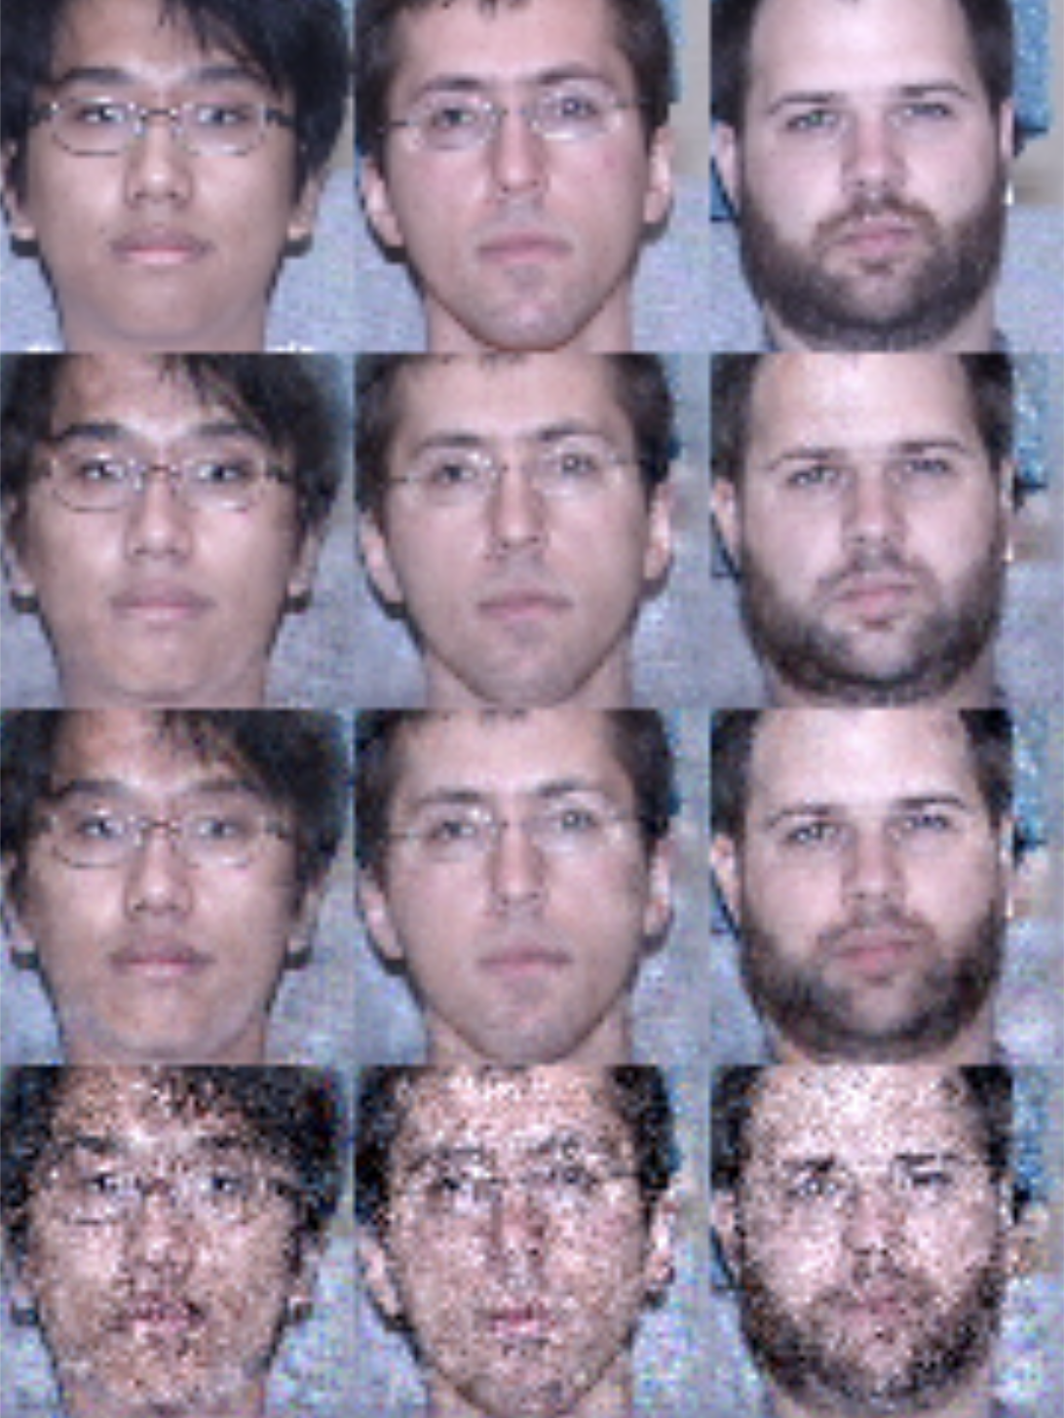
Reconstruction Task
Encoder
Decoder
1.1
0.9
1.0
0.5
2.2
?
6.2
9.5
3.4
1.2
7.4
1.1
0.9
1.0
0.5
2.2
1.1
0.9
1.0
0.1
4.4
tweak features
Matthieu de La Roche Saint André
1.1
0.9
1.0
0.5
2.2
Notes:
Works great with 50 features

Slide 11
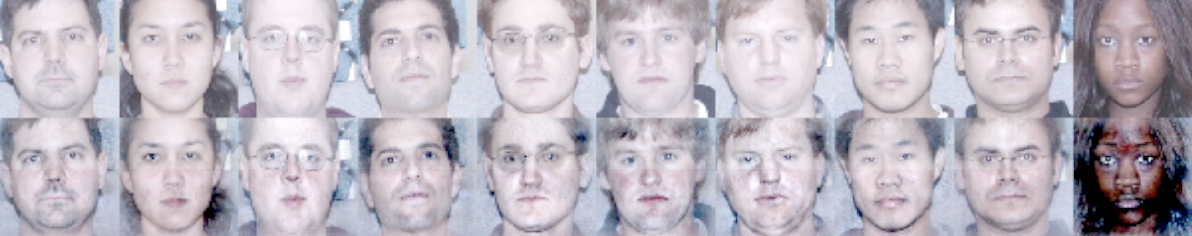
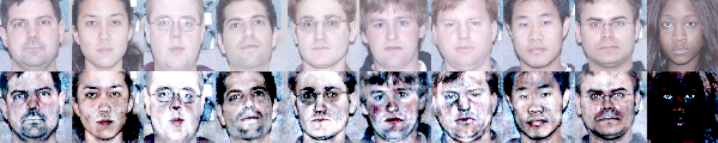
Difference between features and average features has been multiplied by 2
Caricature Generation
1.1
0.9
1.0
0.5
2.2
Matthieu de La Roche Saint André
Difference between features and average features has been multiplied by 5
1.1
0.9
1.0
0.5
2.2
Notes:
Strong colors increased
Shapes unchanges
Why? Too many features?

Slide 12
Reconstruction With Less Features
Encoder
Decoder
1.1
0.9
1.0
0.5
2.2
With 50 floats
Just 1 float:
Overfitting?
1.1
0.9
1.0
0.5
2.2
Just 0 float :
What????
Matthieu de La Roche Saint André
1.1
0.9
1.0
0.5
2.2
Notes:
test set.
Features:
50
1
0

Slide 13
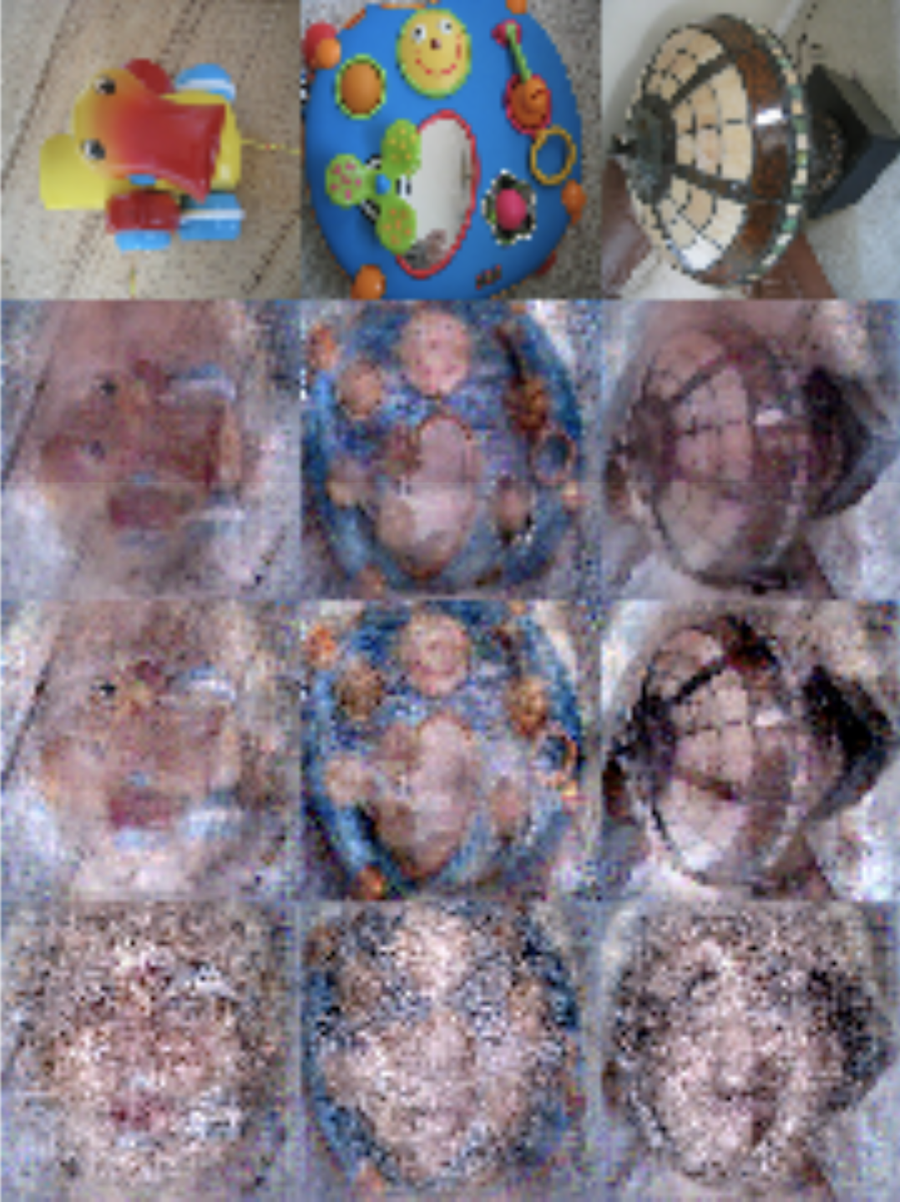
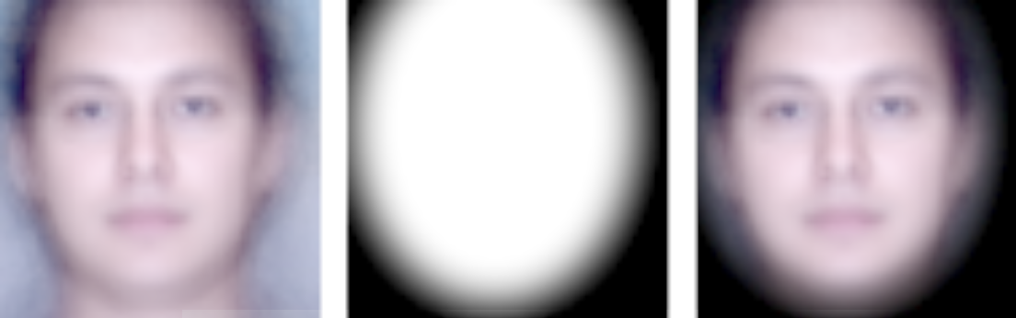
New Faces (ie Test Set)
New and Unrelated Images
Reconstruction Task
Original Image
Face Embedding : 50 floats
Face Embedding : 1 floats
Face Embedding : 0 float
1.1
0.9
1.0
0.5
2.2
Matthieu de La Roche Saint André
> Tunnel Effect <
Overfitting on faces?
1.1
0.9
1.0
0.5
2.2
Notes:
test set.
Features:
50
1
0
Mask applied to images before computing loss. The mask is shown in the middle, with the average face of 100 people on the left and the masked face on the right.

Slide 14
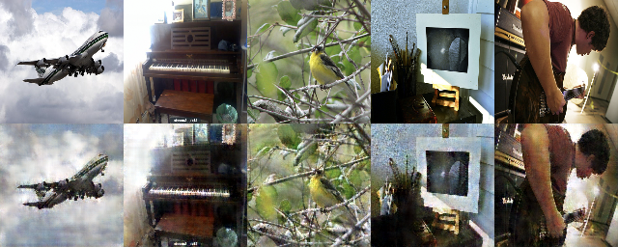
Tunnel Effect
Why?
How did this happen?
Matthieu de La Roche Saint André

Slide 15

Diving into the network
Encoder
Decoder
1.1
0.9
1.0
0.5
2.2
1.1
0.9
1.0
0.5
2.2
Matthieu de La Roche Saint André
1.1
0.9
1.0
0.5
2.2
Notes:
Works great with 50 features

Slide 16
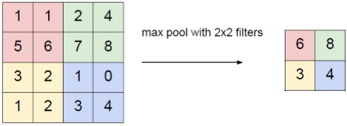
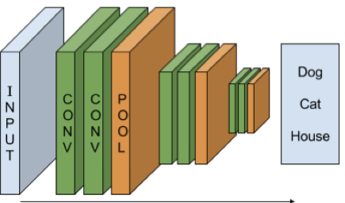
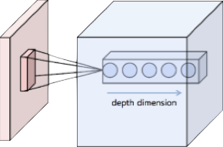
Max-pooling layer
The Encoder: CNN
Convolutional Neural Network
Bottom Right Bottom Right
Top Left Bottom Right
1.1
0.9
1.0
0.5
2.2
“Bob”
“Lee”
“Sam”
Convolution Layer
Matthieu de La Roche Saint André

Slide 17
Diving into the network
Encoder
Decoder
1.1
0.9
1.0
0.5
2.2
1.1
0.9
1.0
0.5
2.2
Matthieu de La Roche Saint André
1.1
0.9
1.0
0.5
2.2
Notes:
Works great with 50 features

Slide 18

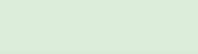
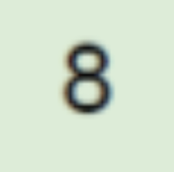


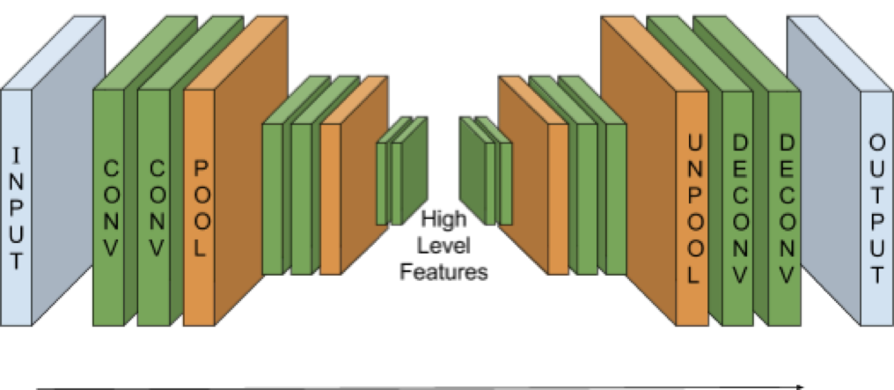


The decoder
Max-unpooling layer
0
0
0
0
0
0
Bottom Right Bottom Right
Top Left Bottom Right
0
0
0
0
0
0
1.1
0.9
1.0
0.5
2.2
Max-pool
switch location
mask
Matthieu de La Roche Saint André

Slide 19
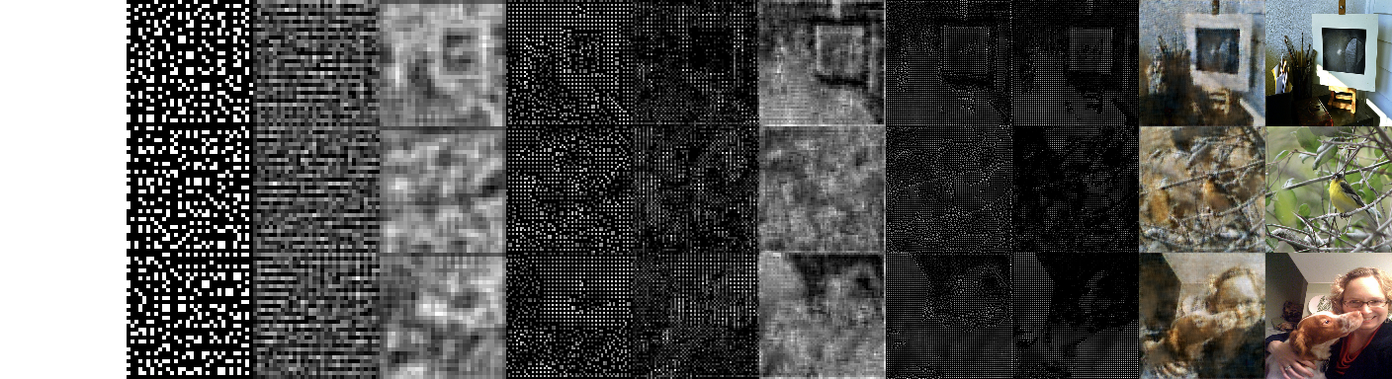
The decoder
1st layer
3rd
5th
Reconstruction
Original
1.1
0.9
1.0
0.5
2.2

Slide 20
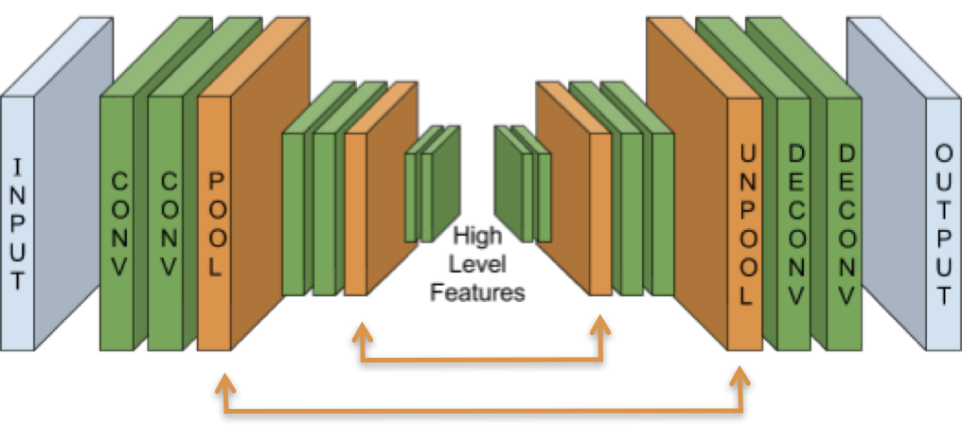
Leak:
Max-pool switch location mask
Matthieu de La Roche Saint André
Max-pool switch location mask 2-14 bits / pixel

Slide 21
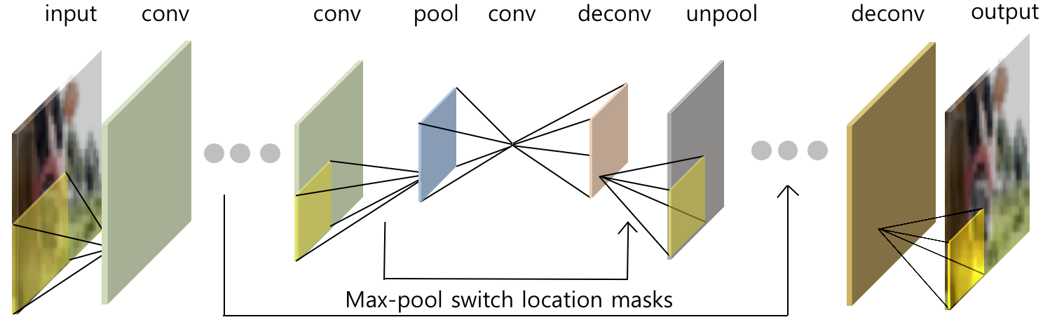
Leak:
Max-pool switch location mask
Matthieu de La Roche Saint André

Slide 22
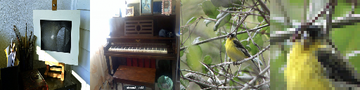
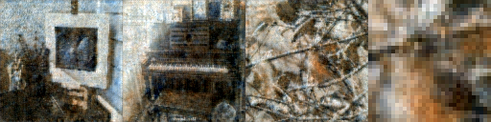
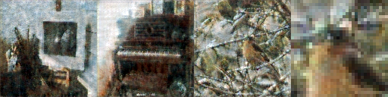
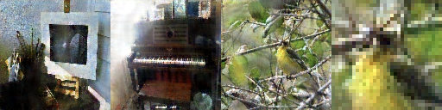
Random Encoder
Original images
Encoder with random weights
(untrained) [16,16,16]
Encoder pre-trained
for classification [16,16,16]
Encoder with random weights
(untrained) [48,96,192]
Matthieu de La Roche Saint André

Slide 23
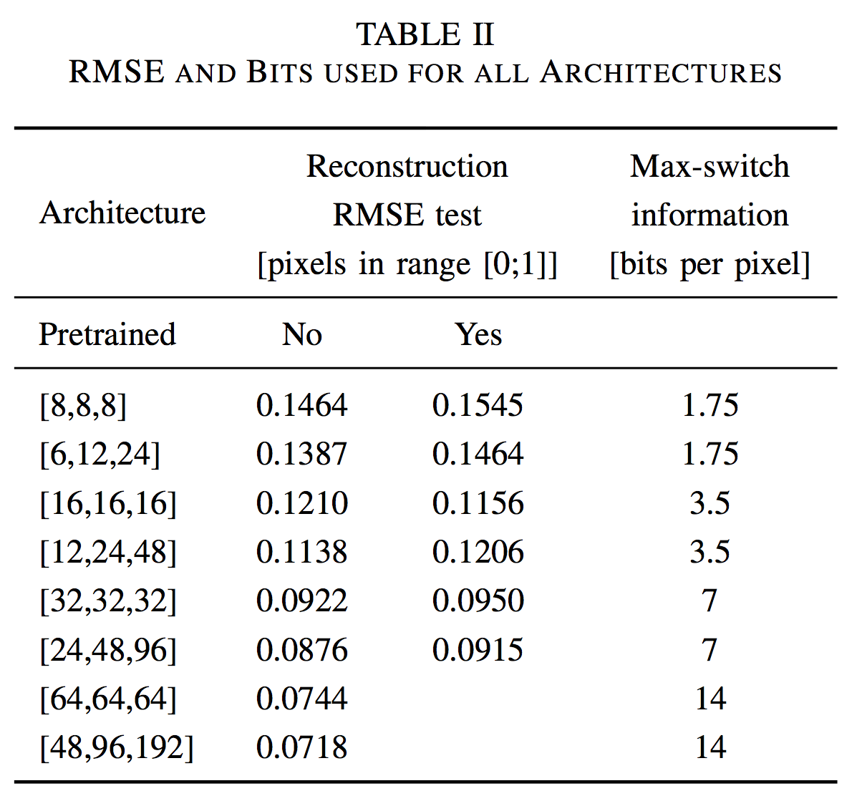
Random Encoder
Root Mean
Square Error
Matthieu de La Roche Saint André

Slide 24
Max-pooling layer
Bonus Track #1
Bottom Right Bottom Right
Top Left Bottom Right
Average-pooling doesn’t work at all
Matthieu de La Roche Saint André

Slide 25
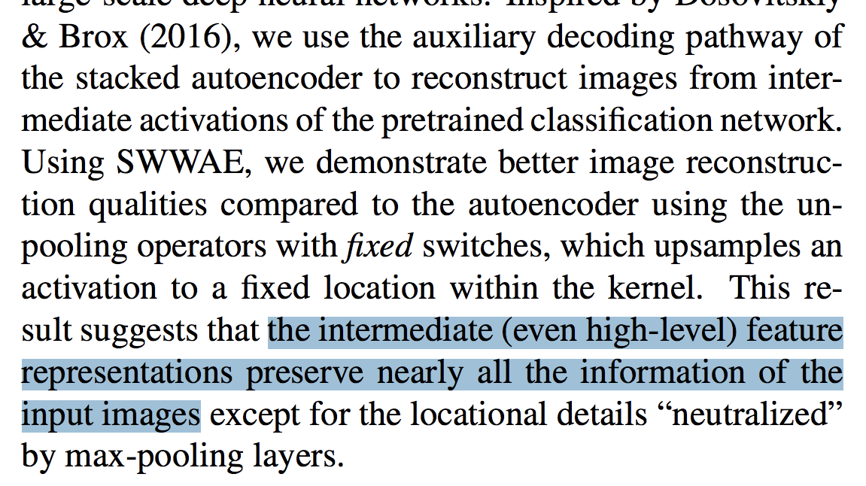
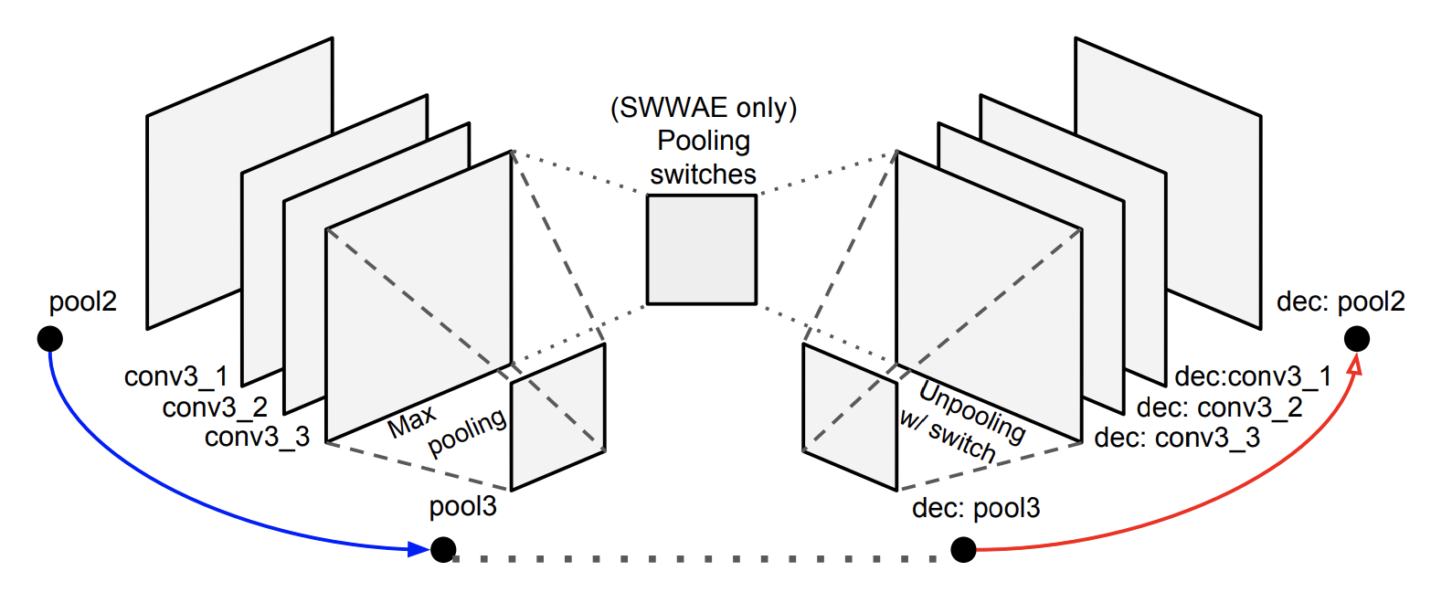
Bonus Track #2
Y. Zhang, K. Lee, and H. Lee, “Augmenting supervised neural networks with unsupervised objectives for large-scale image classification,”
ICML, pp. 612–621, 2016.
Matthieu de La Roche Saint André

Slide 26
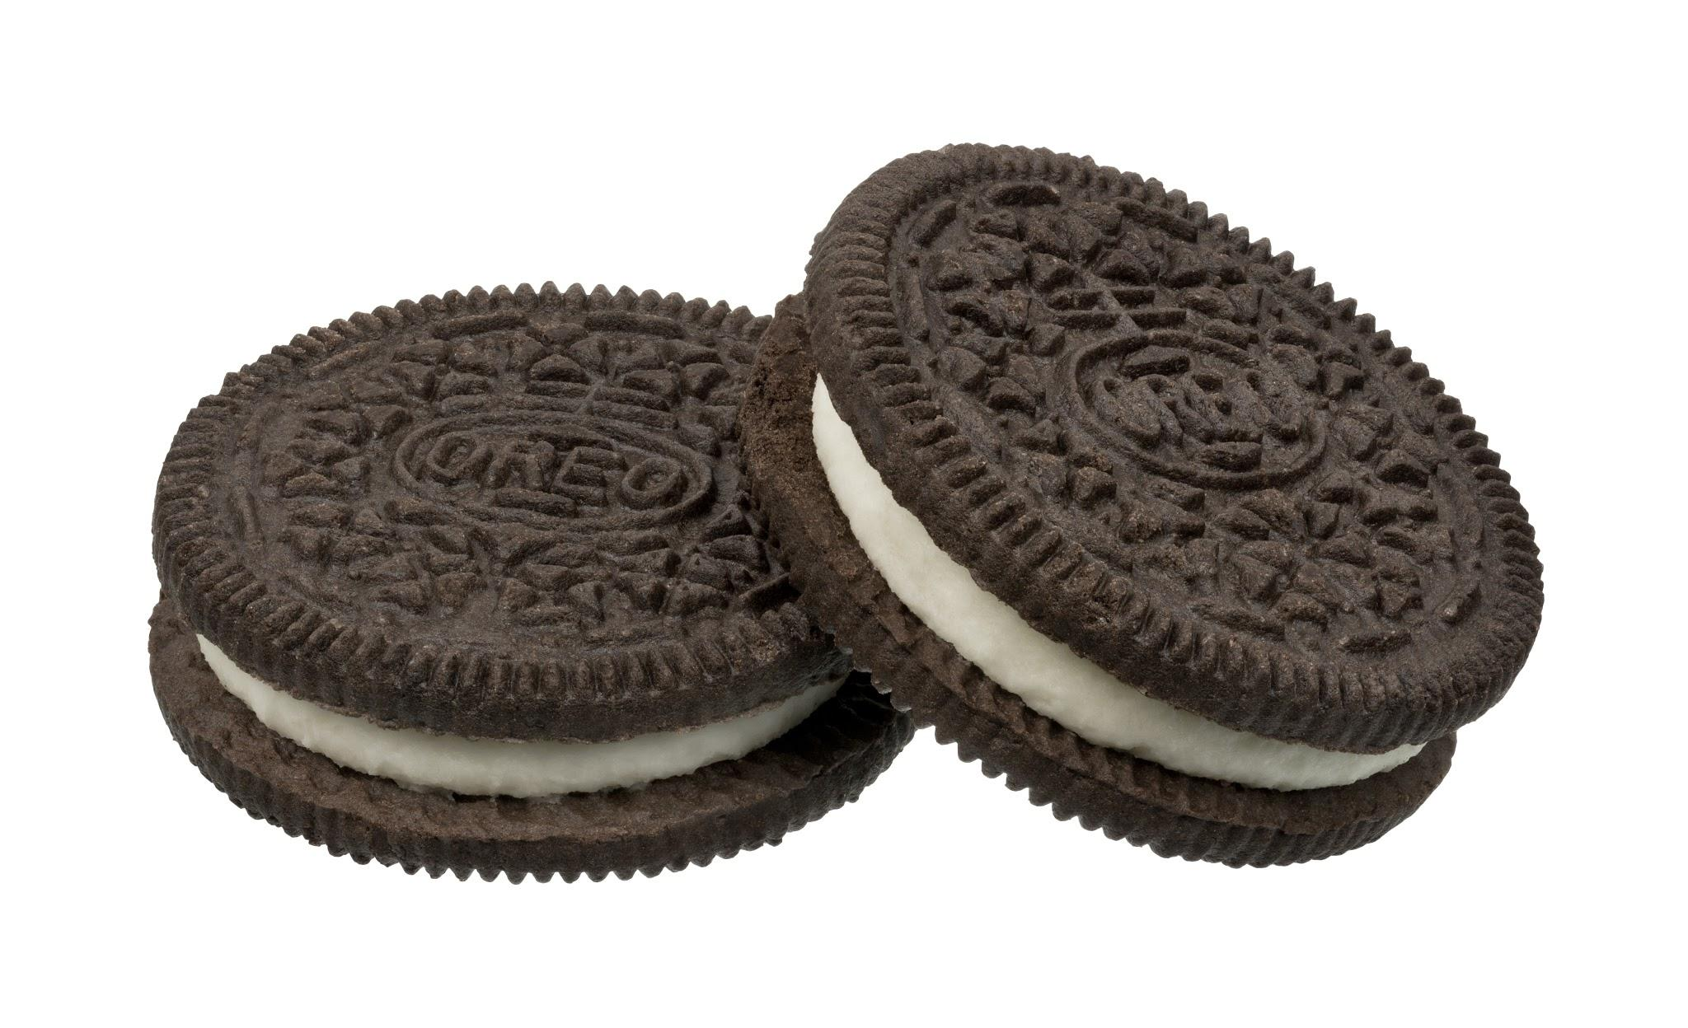
Bonus Track #3
Oreo Training
Matthieu de La Roche Saint André
Notes:
Train same network on both supervised and unsupervised data
But mind the leak! Might get useless features

Slide 27
Take away
Images reconstructed from max-pool switch location mask
♫ Mind the leak between the encoder and the decoder 𝄞 🚆 🚄
Potential pitfall for future architectures
Don’t even need to train the encoder
Neural networks are amazingly adaptable
Potential usages:
image compression
max-pool switch location mask as a new image space representation
single-forward pass artistic style transfer
improve image segmentation
Matthieu de La Roche Saint André

Slide 28
Questions?
Tunnel Effect in CNNs:
Image Reconstruction
From
Max-Switch Location
Matthieu de La Roche Saint Andre, Laura Rieger, Morten Hannemose, and Junmo Kim, "Tunnel Effect in CNNs: Image Reconstruction From Max-Switch Locations," IEEE Signal Processing Letters, vol. 24, no. 3, pp. 254–258, Mar. 2017.
http://ieeexplore.ieee.org/document/7781571/
http://orbit.dtu.dk/ws/files/128168371/double.pdf
Matthieu de La Roche Saint André

